Slide 1

Nested and Correlated Subqueries
Database Management System | SQL and Advanced Query Formulation
Course: Database Management System | Chapter: SQL and Advanced Query Formulation | Program: Bachelor of Engineering
DISCOVER · LEARN · EMPOWER
Notes:
Welcome everyone to today's session on SQL and Advanced Query Formulation. We will dive deep into the mechanics of nested and correlated subqueries. These are powerful tools that allow us to solve complex problems that simple joins cannot handle efficiently. Remember, mastering these concepts is key to becoming a proficient database engineer.

Slide 2
Course Outcomes
SLIDE 2 / 14
Course Outcome
CO | BT LEVEL | DESCRIPTION
CO1 | BT2 | Explain database architecture, relational model concepts and formal query language foundations including relational algebra and relational calculus.
CO2 | BT3 | Apply relational algebra, relational calculus and SQL constructs to formulate correct and efficient database queries.
CO3 | BT4 | Analyze functional dependencies and design normalized relational schemas up to 5NF ensuring lossless join and dependency preservation.
CO4 | BT4 | Analyze transaction schedules and concurrency control mechanisms to determine serializability, recoverability and correctness.
CO5 | BT5 | Evaluate storage structures, indexing strategies and query optimization techniques for performance, scalability and reliability.
Chandigarh University
2 / 14
Notes:
Today's lecture directly addresses our Course Outcomes. CO2 focuses on your ability to write complex SQL constructs like the subqueries we will study. CO3 reminds us that while we write queries, the underlying schema design must remain normalized to ensure data integrity. Understanding how these queries interact with normalized tables is crucial for efficiency.

Slide 3
Learning Objectives
SLIDE 3 / 14
Learning Outcomes
1
Define the structural differences between nested and correlated subqueries.
2
Analyze the execution flow of correlated subqueries against outer tables.
3
Formulate SQL queries using nested subqueries for multi-step filtering.
4
Evaluate performance implications when choosing between joins and subqueries.
5
Identify common syntax errors and logical pitfalls in subquery formulation.
Chandigarh University
3 / 14
Notes:
By the end of this session, you will be able to distinguish between the two types of subqueries clearly. You will understand exactly how a correlated subquery executes row-by-row, unlike a nested one. We will also look at real-world scenarios where one approach is significantly faster than the other. Finally, we will practice spotting errors before they cause runtime failures.

Slide 4
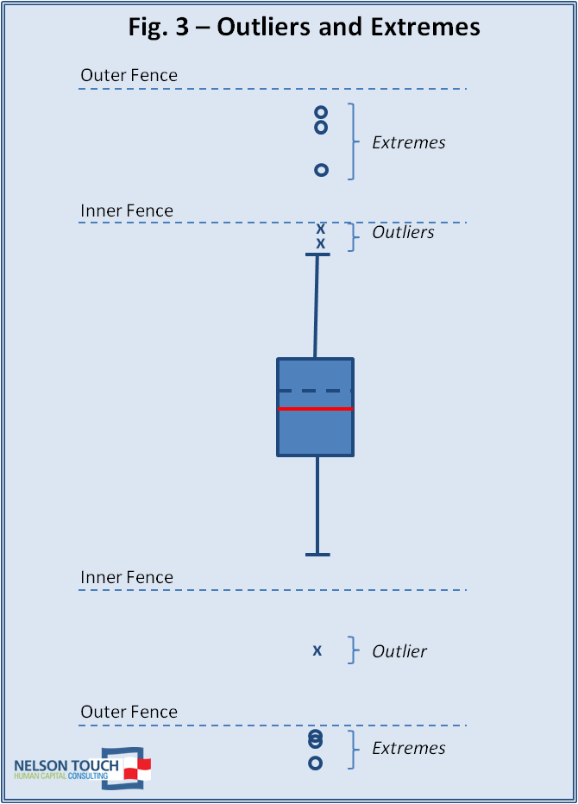
Lecture
SLIDE 4 / 14
Definition of Nested Subqueries
EXECUTION ORDER IS STRICTLY SEQUENTIAL
inner query runs once, then outer query runs.
• A nested subquery is a query embedded within another query's WHERE or HAVING clause.
• The inner query executes first and returns a single value or a list of values.
• The outer query uses the result of the inner query to filter its own rows.
• Nested subqueries are independent and do not reference columns from the outer query.
• They are ideal for static filtering conditions based on aggregate calculations.
Deeper into Box Plots | The Nelson Touch Blog
Chandigarh University
4 / 14
Notes:
Think of a nested subquery as a helper function that runs once before the main task begins. For example, if you need to find employees earning more than the average salary, the average is calculated first. This value is then used to filter the employee list. The inner query does not care about the specific row being processed in the outer query.

Slide 5
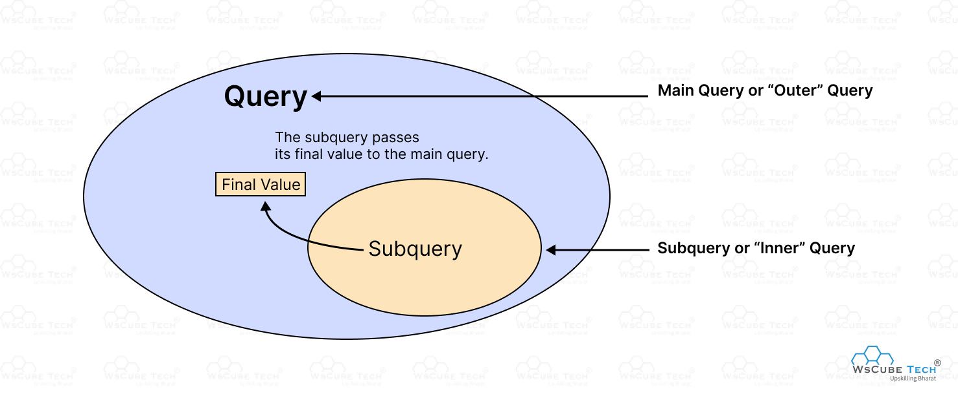
Lecture
SLIDE 5 / 14
Definition of Correlated Subqueries
1
A correlated subquery references a column from the outer query in its WHERE clause.
2
The inner query cannot execute independently and relies on the outer query's current row.
3
The inner query executes once for every single row processed by the outer query.
4
This creates a dependency loop where the result changes based on the outer context.
5
Correlated subqueries are essential for row-by-row comparisons across related tables.
6
They are often used to find 'greatest of' or 'least of' values per group.
Source: deen3evddmddt.cloudfront.net
Chandigarh University
5 / 14
Notes:
Unlike nested subqueries, a correlated subquery is like a loop inside a loop. It runs once for every row in the outer table. Imagine checking if a student's grade is the highest in their specific department; you must compare each student against their own department's average. This dependency makes them powerful but potentially slower if not optimized.

Slide 6
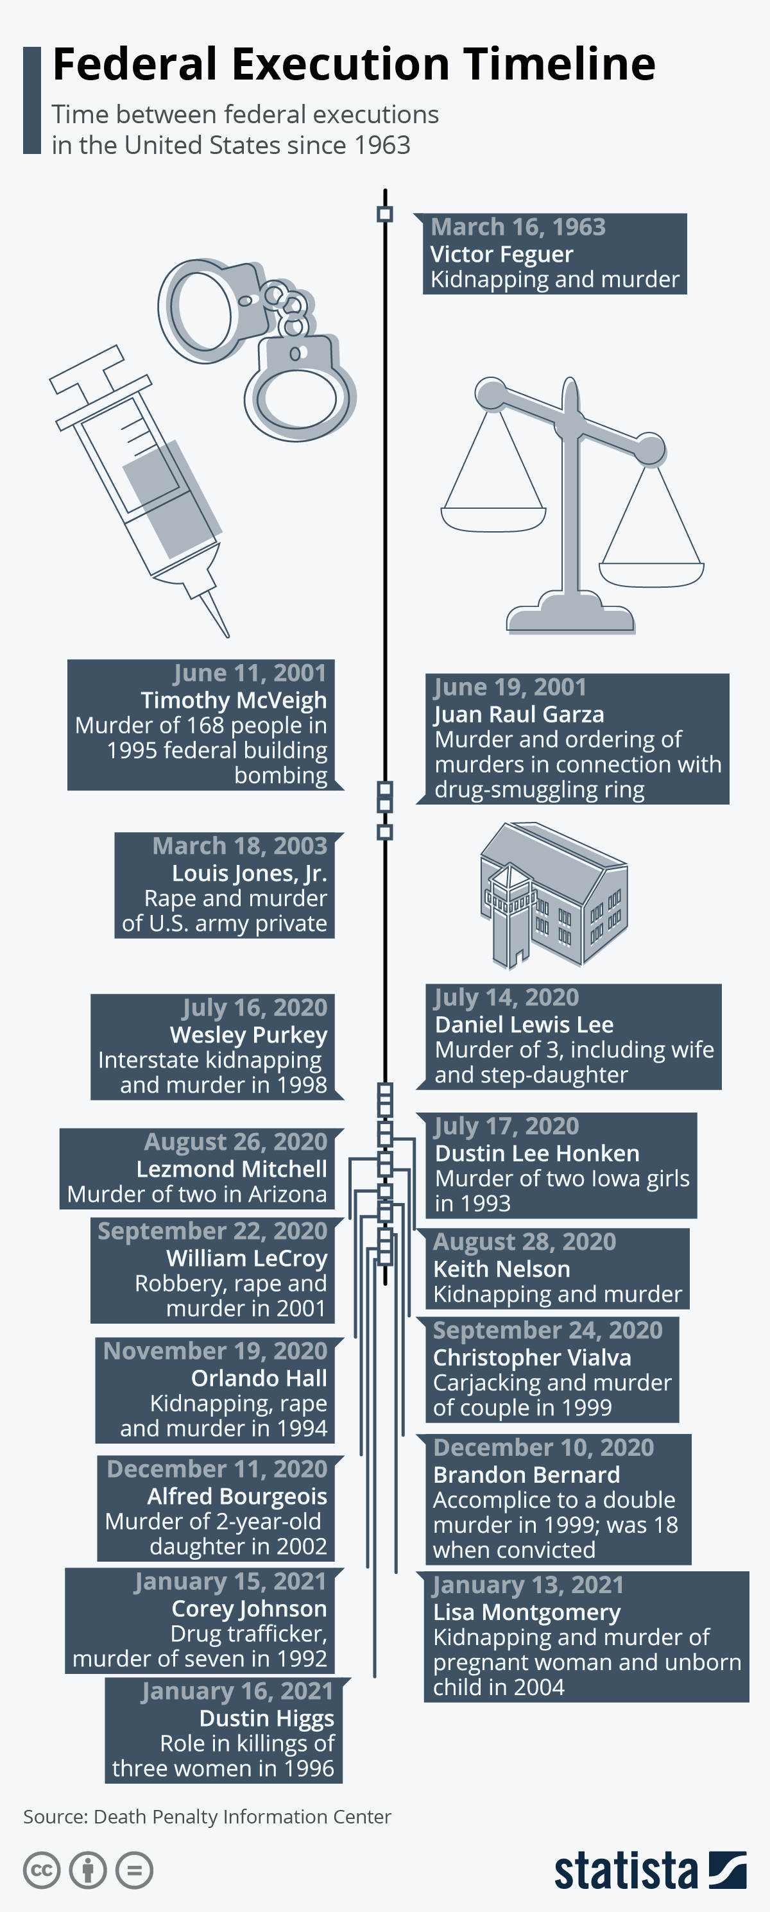
Lecture
SLIDE 6 / 14
Execution Flow Comparison
1
Nested subqueries execute the inner query exactly once before the outer query starts.
2
Correlated subqueries execute the inner query repeatedly, once for each outer row.
3
Nested subqueries return a static result set used for filtering the outer table.
4
Correlated subqueries return a dynamic result set that changes per outer row.
5
Performance of nested subqueries is generally better for large datasets with static filters.
6
Performance of correlated subqueries degrades linearly with the number of outer rows.
Source: cdn.statcdn.com
Chandigarh University
6 / 14
Notes:
Let's visualize the execution. For a nested subquery, the database calculates the average salary once, then scans the table. For a correlated subquery, the database calculates the average salary for the first row, then the second, and so on. If you have 10,000 employees, the correlated version might run 10,000 ×. This is why understanding execution flow is critical for performance tuning.

Slide 7
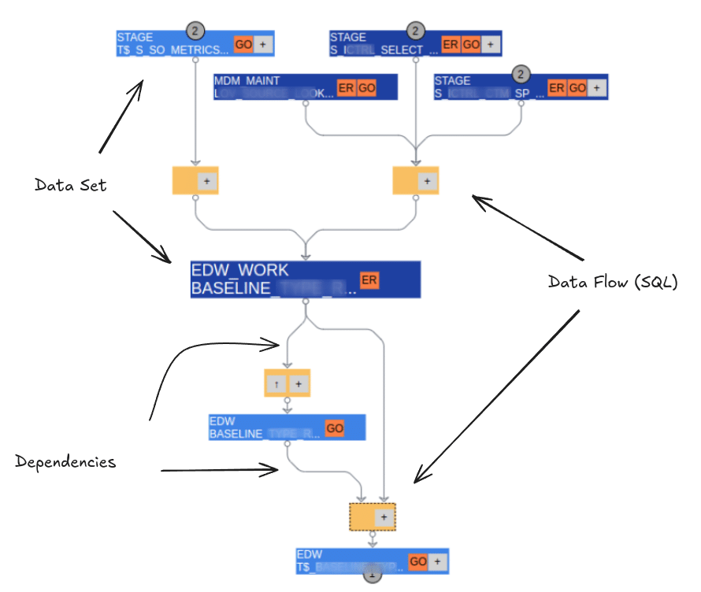
Worked Example
SLIDE 7 / 14
Nested Subquery
GOVERNING EQUATION
Inner Query: SELECT AVG(salary) FROM Employees WHERE department = 'Sales'
GOAL
Find employees earning more than the average salary of the 'Sales' department.
INNER RESULT
Returns a single value, for example, 50000.
OUTER QUERY
SELECT name FROM Employees WHERE salary > 50000.
FINAL OUTPUT
A list of all employees with salaries exceeding the calculated average.
• This approach is efficient because the average is calculated only once.
Source: sonra.io
Chandigarh University
7 / 14
Notes:
Here is a concrete example. First, the database calculates the average salary for the Sales department, let's say it is 50,000. Then, it scans the entire employee table to find anyone earning more than 50,000. The inner query runs once, and the outer query runs once. This is a classic use case for a nested subquery where the condition is static.

Slide 8
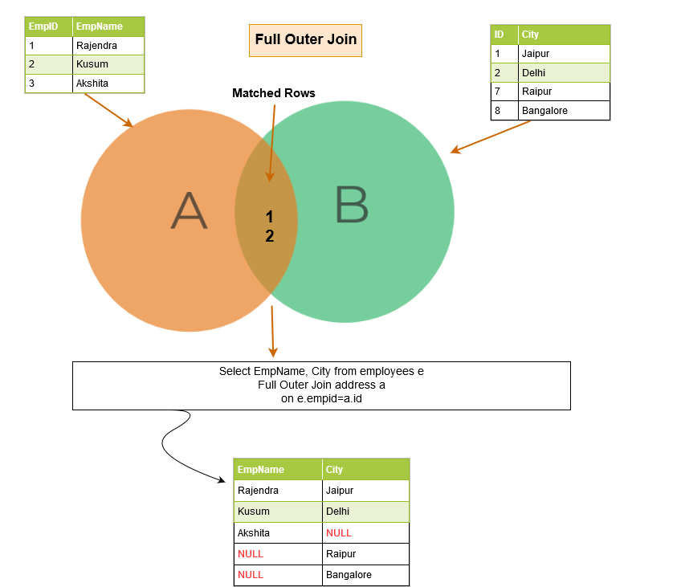
Worked Example
SLIDE 8 / 14
Correlated Subquery
GOAL
Find employees whose salary is higher than the average salary of their own department.
OUTER QUERY
Selects each employee row one by one from the Employees table.
INNER QUERY
Calculates the average salary for the specific department of the current row.
COMPARISON
Checks if the current employee's salary > calculated department average.
RESULT
Returns only those employees who are above their own department's average.
EXECUTION
The inner query runs once for every single employee in the table.
Source: s38063.pcdn.co
Chandigarh University
8 / 14
Notes:
Now, let's look at a correlated example. We want to know who is earning more than their own department's average. For the first employee, we calculate their department's average. For the second employee, we calculate their department's average again. This repeats for every row. If you have 100 employees, the average calculation runs 100 ×. This dynamic nature is the key difference.

Slide 9
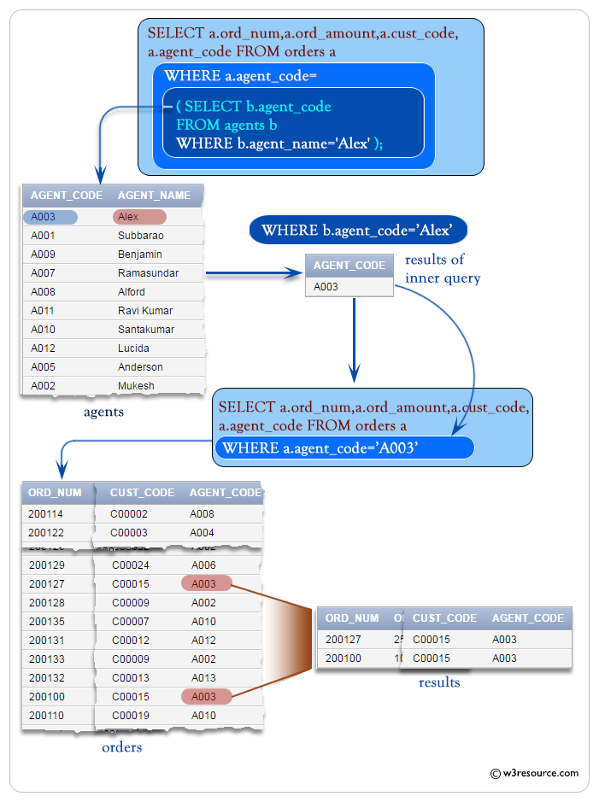
Lecture
SLIDE 9 / 14
Syntax Structure and Aliasing
SYNTAX
SELECT × FROM OuterTable O WHERE condition IN (SELECT ... FROM InnerTable I).
• Nested subqueries typically use standard SELECT statements within parentheses.
• Correlated subqueries require aliasing the outer table to reference it in the inner query.
• The alias 'O' allows the inner query to access columns from the outer table.
• Without proper aliasing, the database cannot resolve the column reference in correlated queries.
• Always ensure the inner query returns a compatible data type for the comparison.
Source: www.w3resource.com
Chandigarh University
9 / 14
Notes:
Proper syntax is vital. In a correlated subquery, you must give the outer table an alias, like 'O'. Then, inside the inner query, you reference 'O.department_id' to link the two. Without this alias, the database doesn't know which table's column you are referring to. This linking is what creates the correlation and the row-by-row execution.

Slide 10
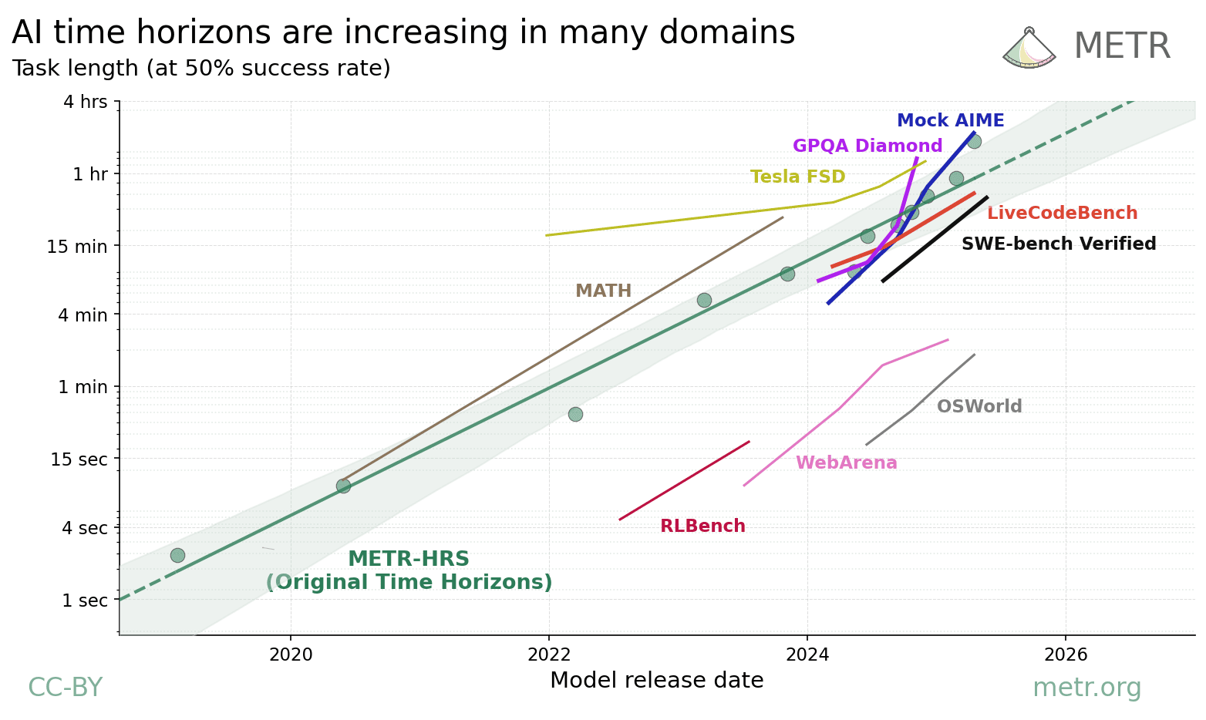
Lecture
SLIDE 10 / 14
Performance Implications
1
Nested subqueries often translate to efficient joins by the query optimizer.
2
Correlated subqueries can cause performance bottlenecks on large datasets.
3
The cost of a correlated subquery is proportional to the number of outer rows.
4
Optimization techniques include converting correlated subqueries to JOINs or EXISTS.
5
Use EXPLAIN plans to analyze the execution cost of your subqueries.
6
Indexing the correlated columns can significantly reduce the execution time.
Source: metr.org
Chandigarh University
10 / 14
Notes:
Performance is a major concern here. A nested subquery might be optimized into a join, which is very fast. A correlated subquery, however, forces the database to re-evaluate the inner query for every row. If you have a million rows, that's a million evaluations. Always check your execution plans and consider rewriting correlated subqueries as joins for better performance.

Slide 11
Lecture
SLIDE 11 / 14
Common Pitfalls and Errors
GOVERNING EQUATION
Returning multiple rows in a subquery used with a scalar operator like '='
1
Forgetting to alias the outer table in a correlated subquery definition.
2
Creating infinite loops by referencing the same table without proper filtering.
3
Using NULL values incorrectly in comparisons within subquery conditions.
4
Assuming correlated subqueries are always slower without checking the data size.
5
Mismatched data types between the subquery result and the comparison column.
Chandigarh University
11 / 14
Notes:
Let's talk about mistakes. A common error is using a subquery that returns multiple rows with the equals sign. You must use IN or ANY for multiple rows. Another pitfall is forgetting the alias, which leads to 'ambiguous column' errors. Also, be careful with NULLs; a comparison with NULL often yields unknown results, which can filter out valid rows unexpectedly.

Slide 12
Lecture
SLIDE 12 / 14
Optimization Strategies
1
Rewrite correlated subqueries using JOINs or LEFT JOINs where possible.
2
Use the EXISTS operator instead of SELECT × for existence checks.
3
Ensure indexes exist on the columns used for correlation and filtering.
4
Limit the result set of the inner query to reduce processing overhead.
5
Consider using Common Table Expressions (CTEs) for complex nested logic.
6
Analyze query execution plans to identify specific bottlenecks in the flow.
Chandigarh University
12 / 14
Notes:
How do we fix slow queries? Often, we can rewrite a correlated subquery as a JOIN. For example, instead of checking 'exists', we can join the tables and filter. Using the EXISTS operator is also more efficient than SELECT × because it stops searching as soon as it finds a match. Always check your indexes; if the correlated column isn't indexed, the database has to scan the whole table every time.

Slide 13
Lecture
SLIDE 13 / 14
Key Takeaways
1
Nested subqueries execute once and are independent of the outer query rows.
2
Correlated subqueries execute row-by-row and depend on the outer query context.
3
Correlated subqueries require table aliases to link inner and outer tables.
4
Performance of correlated subqueries degrades with larger datasets compared to joins.
5
Always analyze execution plans and consider rewriting for optimization.
Chandigarh University
13 / 14
Notes:
To summarize, remember that nested subqueries are static and run once, while correlated subqueries are dynamic and run for every row. The key to writing correlated subqueries is using aliases to link the tables. While powerful, they can be slow, so always consider rewriting them as joins for better performance on large datasets. These concepts are fundamental for writing efficient SQL.

Slide 14
Lecture
SLIDE 14 / 14
References
1
Fundamentals of Database Systems — Ramez Elmasri & Shamkant B. Navathe
2
Database System Concepts — Silberschatz, Korth & Sudarshan
3
Database Management Systems — Raghu Ramakrishnan & Johannes Gehrke
4
Oracle/MySQL Documentation — Oracle
Chandigarh University
14 / 14
Notes:
For further reading, I recommend the standard texts by Elmasri and Navathe, as well as Silberschatz. Ramakrishnan's book is also excellent for understanding the theoretical underpinnings of query processing. Finally, always refer to the official Oracle and MySQL documentation for the latest syntax and optimization features. Thank you for your attention.

